Slide 1
Pottery

Slide 2
is super fun.

Slide 3
The dream.

Slide 4
The Reality☺

Slide 5
Stick with it.

Slide 6
You’ll get it.

Slide 7
What we are not going to make:

Slide 8
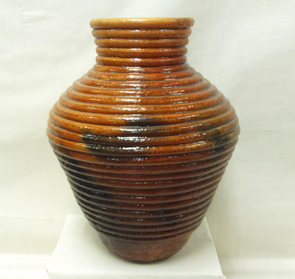
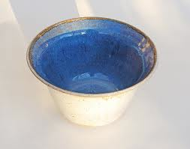
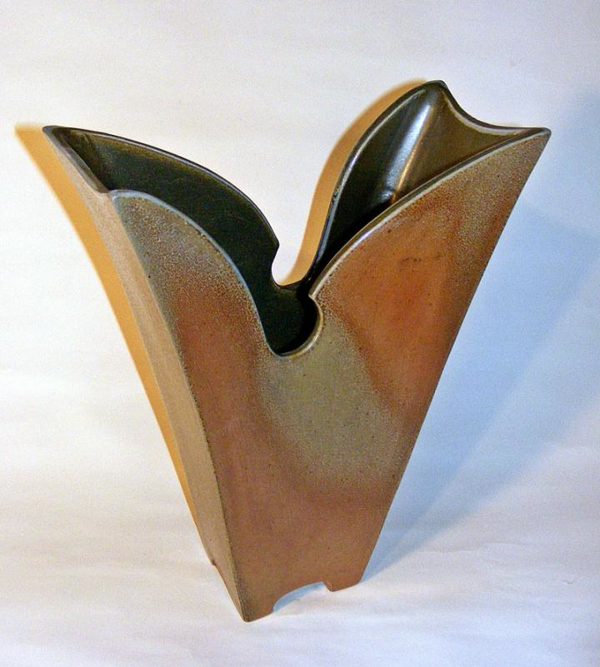
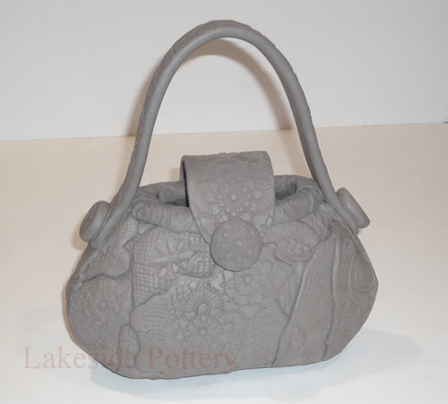
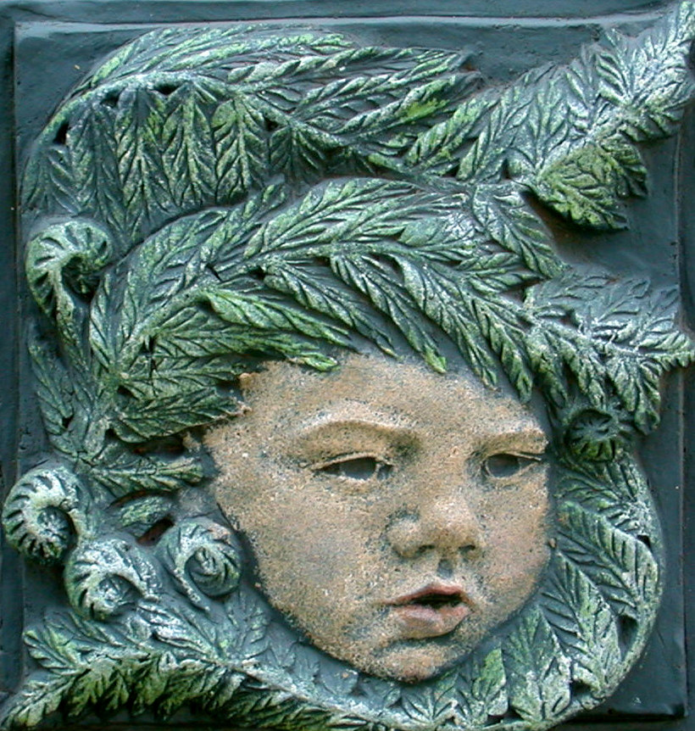
What we will work on:

